Slide 1
Capstone Project
Index of refraction of Water
Adrian Allen Mercado
Charline Jean Pierre
Florida Cishesa
Joel Graf

Slide 2
Introduction

Slide 3
The goal of this experiment is to test a method to find the index of refraction of water by using Snell’s law which is given by :
n₁ sin(θ₁)= n₂sin(θ₂)
where n represents the index of refraction of each material, in our case is air and water.
θ₁ is angle of incidence and θ₂ is angle of refraction.
The material used included a plastic container, a laser pointer ,and water .

Slide 4
First Run Procedure

Slide 5
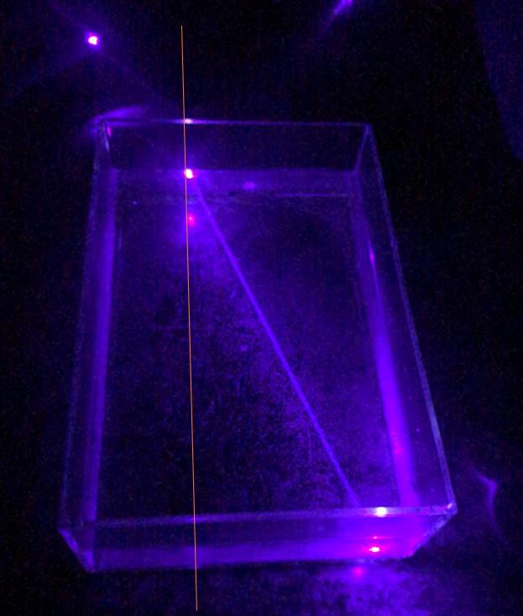
About two third of the container was filled with water. Then the light of the beam was pointed so that it hit one side of the container to make the incident angle, then the light refracted at another side of the container.
Different methods were used by each group member for finding multiple angle of incidence and refraction.

Slide 6
First Data

Slide 7
Angle of incidence | Angle of refraction
29 ± 1.5 | 21 ± 1.5
10 ± 1.5 | 8.2 ±1.5)
28 ± 1.5 | 23 ±1.5
11 ± 1.5 | 7.5 ± 1.5
15 ± 1.5 | 11 ± 1.5
20 ± 0.9 | 14.54 ± 0.03
30 ± 0.9 | 21.398 ± 0.03
35 ± 0.8 | 24.967 ± 0.03
25 ± 0.9 | 18.303 ± 0.03
15 ± 1 | 11.365 ± 0.03
5 ± 1 | 3.785 ± 0.03
55 ± 0.858 | 32.5 ± 0.527

Slide 8
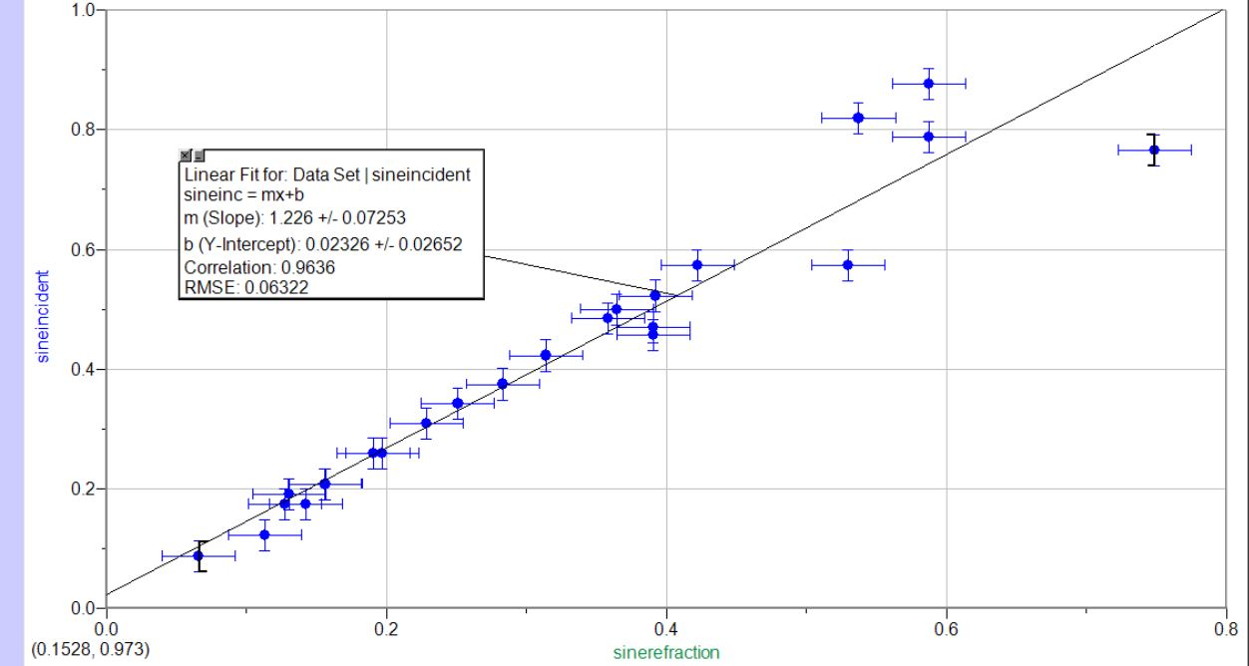
Slope = 1.226 ± 0.07253 Accepted value n_{w} =1.33

Slide 9
Initial Run Analysis/Conclusion Cont.
Accepted Value: n=1.33
Experimental Value: n=1.26 ± .07
sin(𝜃_{I})/sin(𝜃_{R}) = n
The theoretical value seems to be “trending” towards the “accepted” value but it doesn’t exactly agree with the accepted value itself. This brings up questions such as:
Is the data legitimate?
Does the data disprove the value, 1.33?

Slide 10
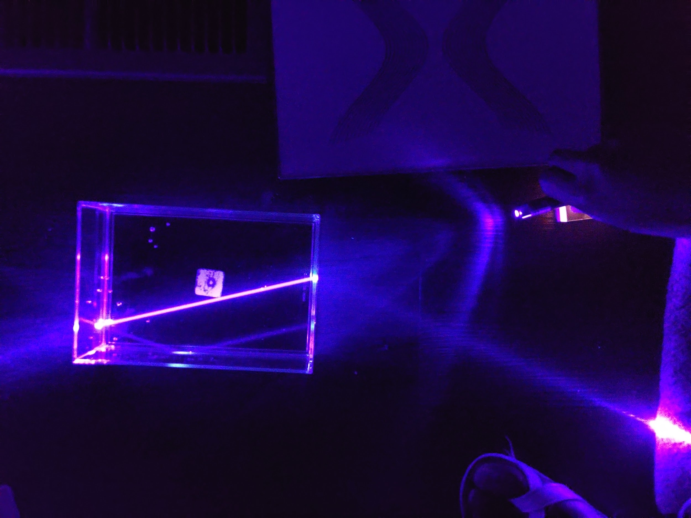
Drawbacks
Multiple Procedures
Ways of measuring
Lack of Uniformity

Slide 11
Second run Procedure

Slide 12
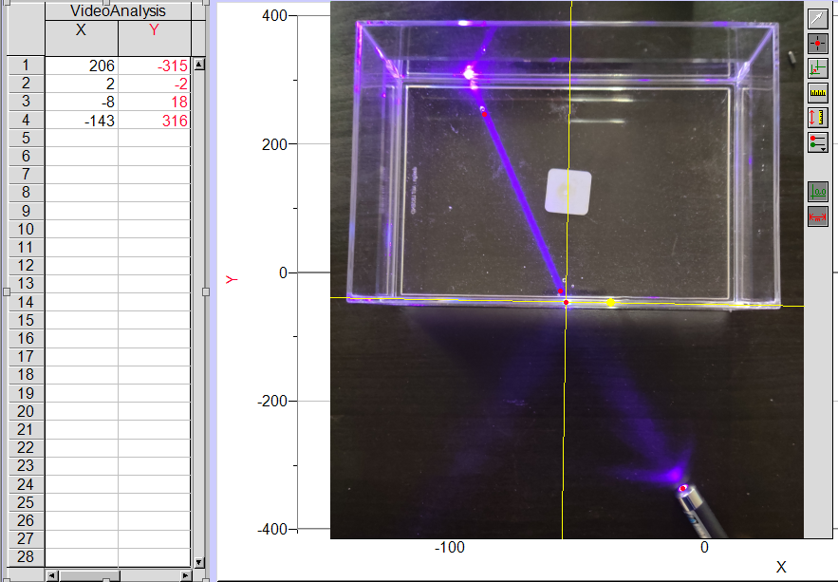
About two third of the container were filled with water.
The ray of the laser hit the container at some angle to the normal.
Carefully, we took a picture using our smartphones, by making sure the plane of the camera is right about the incident point and parallel to the plane of the container.
We inserted the image in logger pro, then we located several points on the light ray
We made sure the points are far enough from each other to minimize the error.
We found the slope of the ray.
We used arctangent to find the angle.
We checked the correct angle.

Slide 13
Final Data

Slide 14
 | Partial Data Table
 | Incident angle ( °) | Refracted Angle ( °)
1 | 1.32 ± 2 | 0.4 ± 2
2 | 51.2 ± 2 | 37.7 ± 2
3 | 42.2 ± 2 | 31.4 ± 2
4 | 20.0 ± 2 | 15.2 ± 2
5 | 21.3 ± 3 | 17.5 ± 2
6 | 28.4 ± 3 | 22.6 ± 2
7 | 47.9 ± 2 | 33.4 ± 2
8 | 37.4 ± 2 | 26.7 ± 2
9 | 76.1 ± 3 | 45.7 ± 5
10 | 60.9 ± 4 | 40.7 ± 5
11 | 20.7 ± 3 | 15.6 ± 4
12 | 61.9 ± 5 | 42.5 ± 4
13 | 41.3 ± 3 | 31.2 ± 3
14 | 37.9 ± 3 | 26.4 ± 3

Slide 15
Analysis
Snell’s Law n₁sin(𝜃_{I})=n₂sin(𝜃₂)=>
=>n₂=n₁sin(𝜃_{I})/sin(𝜃₂)
Plotted function: Y= Sin(𝜃_{I}) X= Sin(𝜃_{R})
Slope: Δsin(𝜃_{I})/Δsin(𝜃_{R})
Slope: 1.33 ± 0.015
Intercept: -0.0043 ± 0.007
Accepted value of index of refraction: 1.333

Slide 16
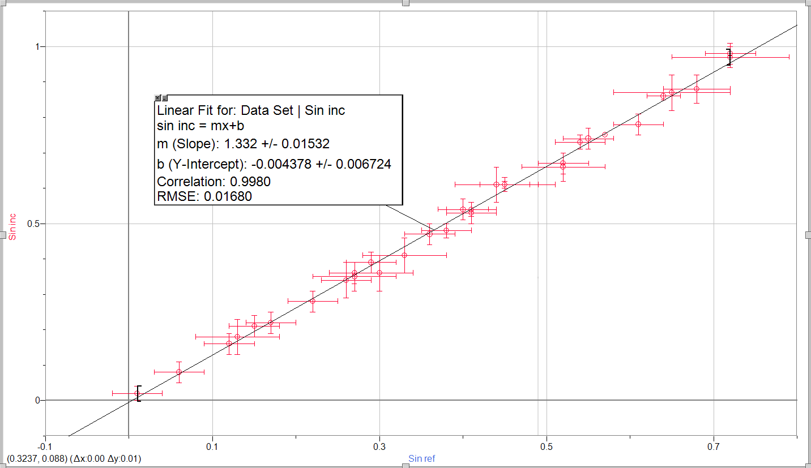

Slide 17
Uncertainty Analysis

Slide 18
Sources of Uncertainty
Uncertainty
Beam measurement
photo parallax
Data Scatter
How it was mitigate
Used a digital method of measurement
used leveling feature and aligned camera with axis
used more consistent procedure
Final uncertainty calculation
F = f(A) => δF = δA x (df(x)/dx)|_{x=A}

Slide 19
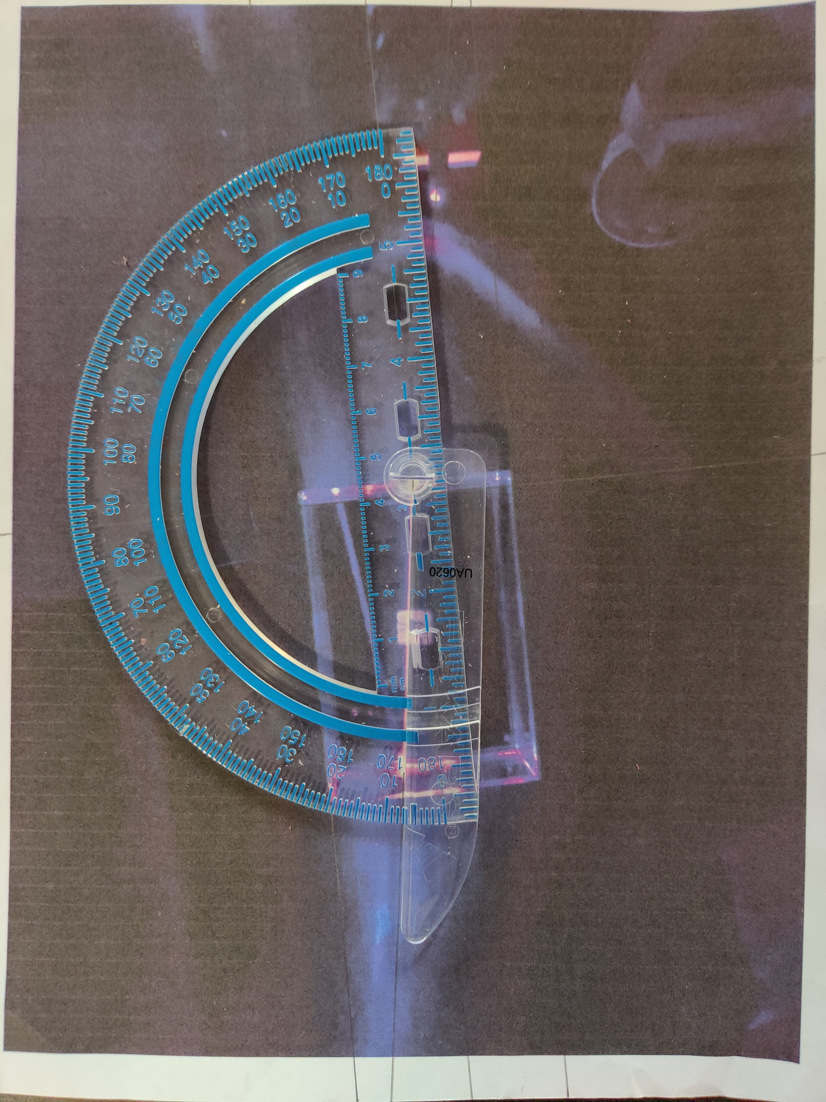
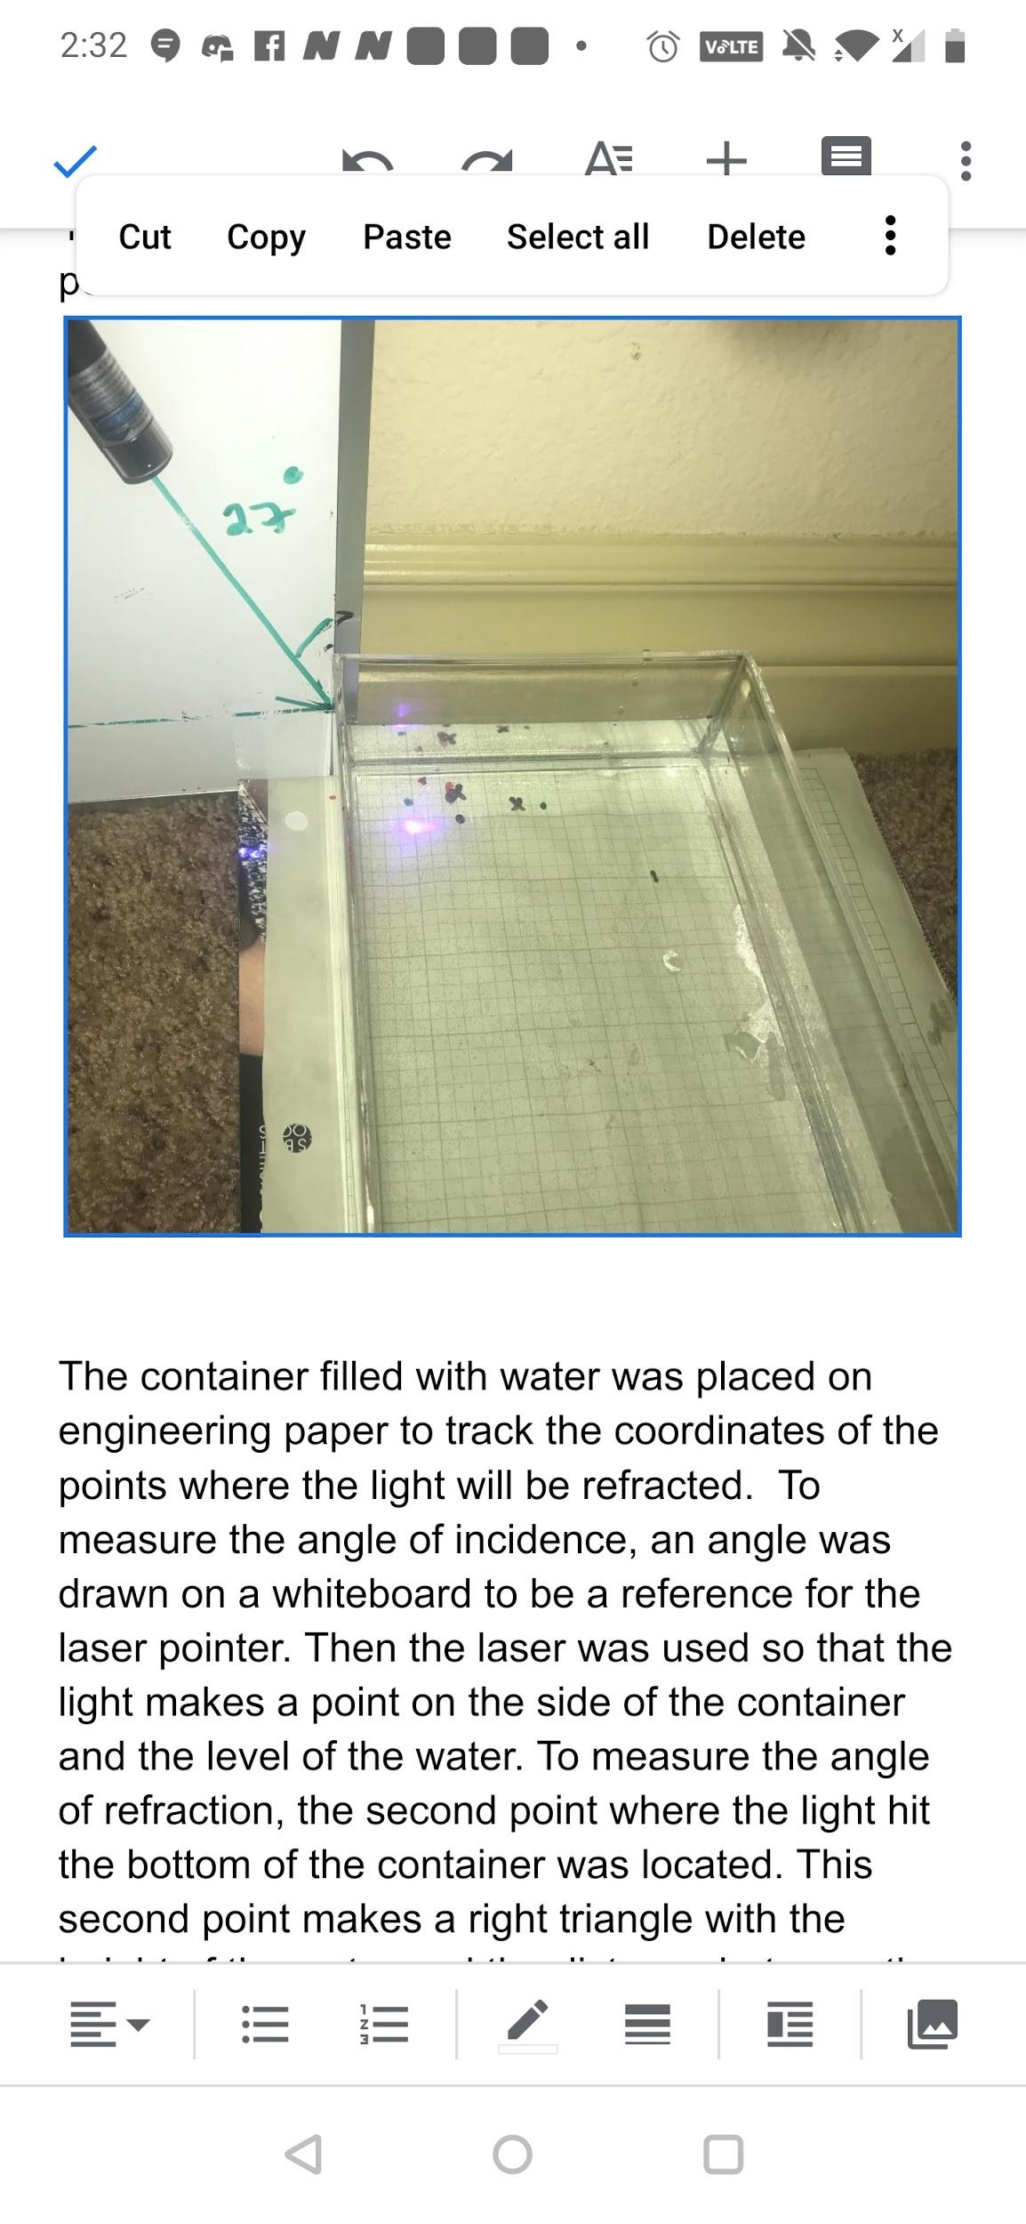
Comparison and Improvements
For the first run of data collection:
Different methods were used.
The measurements were not very precise.
The instruments of measurement we used added errors in our data.
It required much work.

Slide 20
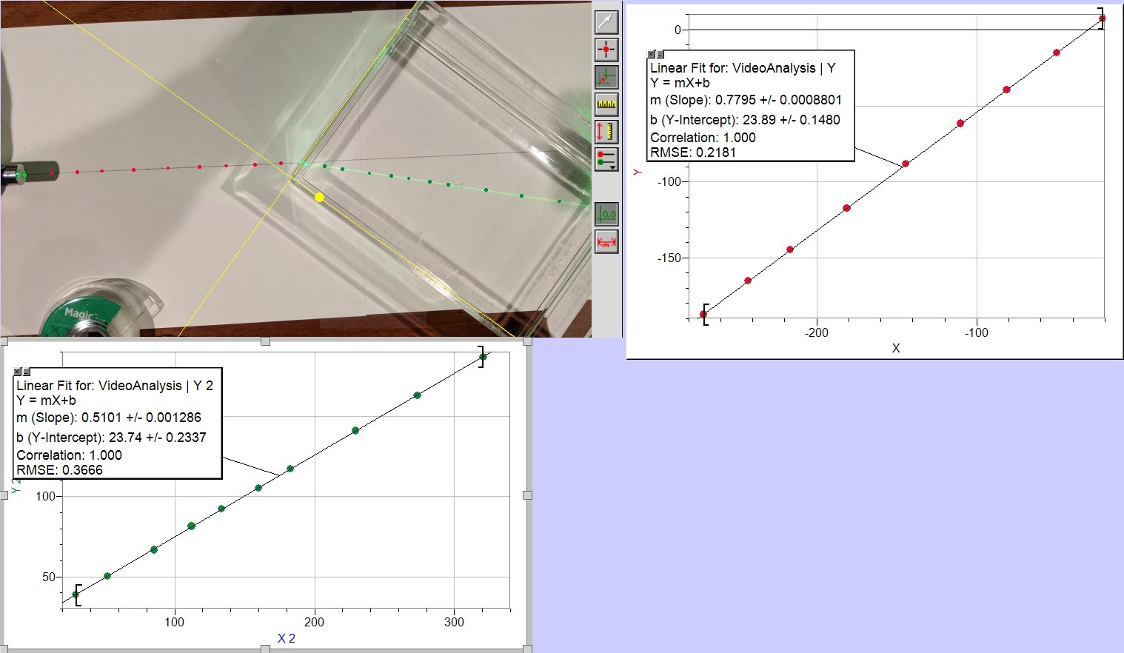
For the second run of the data collection:
We used identical procedures.
We used the camera to report the precise angle.
We used an online protractor which provided a higher level of accuracy, and we used logger pro to have a more precise slope and estimation of the uncertainties.
We used arctangent to find the angle from the slope, which minimizes the error in the measurement.
The collection of data became easier and allowed us to take more data.
More data than the first run, which increase the precision of the result.

Slide 21
Conclusion
The goal:
To test a method to find the index of refraction of liquids - water:
Find out what the index of refraction of water is.
How it compares to value provided by the general community.
Our experimental value:
n(water)=1.33±0.015
The general community’s value:
n(water)=1.333
The two values agree.

